Slide 1
Collaboration: A Different Approach Working with Aboriginal Families in Calgary
Hazel Bergen, Program Director
Mahmawi-atoskiwin
Carmen Esch, Associate Director CFS

Slide 2
Engaging Aboriginal Families Through Collaboration
OVERVIEW
CFS:
Context/History
Aboriginal Framework
Evolution of Practice
Mahmawi-atoskiwin:
Alliance
Practice
Collaboration
Outcome Data:
What’s working well
Moving Forward

Slide 3
Engaging Aboriginal Families Through Collaboration
In 2009, the leadership team began to development of the Aboriginal Framework
PRINCIPLES:
Culture and Language
Self Determination
Holistic Approach
Ongoing Learning/Best Practice
Notes:
Office composition: 13 teams, 5 managers, 100 staff and working with approximately 1100 children
Needed a framework which would guide all of our practice and decision making. At the time we noted that the aboriginal population in Calgary increased by 75% between 1996 and 2006. at the time ab families involved in child welfare system in Calgary was 33%. Based on consultation, practice and published research the framework principles and practices would be used to restructure and increase regional capacity to deliver effective and culturally appropriate services to aboriginal families in Calgary
VISION: All Aboriginal Children will be safe and secure and have a sense of belonging founded in family
Families will be respected and supported
Families and communities will have a strong voice in the planning for children
Principles
Culture and Language: Aboriginal cultures, traditions, knowledge, values and practices will be strongly embedded in planning and service delivery for aboriginal clients. Ensure a cultural plan is developed for each child, language supports, cultural competency, look toward kinship
Self Determination: Aboriginal children, families and communities will have a strong and ongoing voice in decision making and service delivery. Meaningful band consultation
Holistic Approach: For children to be safe, their families and communities must be safe from poverty, inadequate housing unemployment additions and racism. Holistic supports healing.
Ongoing learning/best practice: best practices will be cultivated through a commitment to ongoing learning, reconciliation collaboration and mutual support.

Slide 4
CFS: Evolution of Practice Through the Lens of Engagement and Collaboration
ENGAGING WITH FAMILIES, COMMUNITIES AND PARTNERS
Provincial and regional legislative, policy and practice shifts
Office Reorganization – Community based teams
Elder program
Kinship Search
Relationship Building
Meaningful Band Consultations
Permanency Planning
Implementation of evidenced based/innovative practice
Notes:
Followed all provincial and regional shifts
2011 – office reorganization. Work with children and families from over 100 bands. Moved to community based teams. 2 assessment teams, 2 treaty 7, 2 treaty 6/8, 2 Saskatchewan, 1 other provinces, 1 metis team, 2 permanency teams and 1 adolescent team – purpose to cultivate relationships with the dfnas, band designates and have staff more competent with the culture of the children they are working with.

Slide 5
Engaging Aboriginal Families Through Collaboration
Engaging with First Nations:
Meaningful Band Consultations
Returning children for community events/visits
Elder Program
Kinship Search
Cultural Camp
Notes:
Relationship building and Meaningful band consultations: due to restructuring we cultivated / established relationships. Began going out to the first nations to do consultations. Had them assist with the cultural plan for the child, sought extended family options, had the designates go out to homes to visit their children. Began taking children to their communities: past spring took 17 children to the yellow quill treaty days. Took 7 children to mohawk nation to meet extended family.
3 elders who provide support to our children and families provide ceremony, support.
2012 – kinship search program – 2 kin workers whose role was to look for and engage with extended family. If children need to come into care, they are placed with family.
Permanency planning – working with immediate family, extended family and the nation to assist in ensuring children do not languish in foster care.
September had our first annual cultural camp. Kananaskis, 10 families. Fri – sun. Children had opportunity to build a blackfoot sweatlodge participate in a cree sweatlodge. Traditional and metis dancers, drummers. Teachings by the elders.

Slide 6
Engaging Aboriginal Families Through Collaboration
Incorporating New Practice Models:
Implementation of Practice Strategies
Signs of Safety
Other evidenced based practices
Notes:
2013 began Signs of Safety, Piloted Front end stategies (based in research – alberta incident study) – now the practice strategies adopted by the province.
Beginning down the road of Darla Henry’s 3-5 - 7

Slide 7
Engaging Aboriginal Families Through Collaboration
Aboriginal Services OBSD Tender
Mahmawi-atoskiwin
Relationship building
Collaborative practice
Notes:
2012 – tender for ab services obsd.
Engaged all of our partners in the process. Invited director or designate from each dfna, metis nation of alberta, metis settlements
Awarded to mahmawi-atoskiwin.
Relationship building to come to collaborative practice

Slide 8
Mahmawi-Atoskiwin
Mahmawi-Atoskiwin is an alliance of three agencies, Boys and Girls Clubs of Calgary; Enviros; and Pathways Community Services Association
Each agency has taken a lead role in some aspect of Mahmawi-atoskiwin
Our model is based on the practices developed by Kahkiyaw in Edmonton

Slide 9
Mahmawi-Atoskiwin began delivering service in July 2013 and has been working in collaboration with CFS since that time
The model is based on creating a Family Wellness Team that includes:
The Family
Extended Family and Friends
CFS Caseworker
Family Wellness Partner (Mahmawi-atoskiwin key worker)
Circle Keeper (Mahmawi-Atoskiwin staff to assist with cultural connections and supporting the circle)

Slide 10
Roles:
Family Wellness Partner
Family Wellness Partner provides support to the family to implement the actions identified through the Signs of Safety Mapping
Lodge Keeper
The Lodge Keeper is there to assist with providing some of the instrumental supports to families. Part of the role may include assisting with supported visits if the child has come into care.

Slide 11
Roles
Circle Keeper
The Circle Keeper is someone who is culturally connected and is able to facilitate, lead and create peace
Elders
Work with families in their homes
Conducts ceremonies
Support staff members

Slide 12
From July 2013 to the end of September 2014 Mahmawi-Atoskiwin staff were involved with 480 children
Mahmawi-Atoskiwin becomes involved with families begins during the assessment phase
Collaborating with the assessors and the family has provided an ability to address concerns in a quick and immediate way
Most of these children have remained in their homes, with their moms and dads or extended family members

Slide 13
Collaborative Case Management
Families continue to receive support from a Family Wellness Partner and a case-worker
When a Family Enhancement Agreement is signed, the Family Wellness Partner works to support the family to achieve their goals
These supports are flexible and work with the family on what is important to them (established through signs of safety mapping)
Notes:
Teen story of a mom and daughter who were fighting with each other; - the teen girl did not have many positive things going on in her life and was interested in becoming involved in things outside the home;
The FWP was able to find a creative photo therapy group for her to join which the teen quickly became very interested in (available in the community); the teen was motivated to get there on her own and this has assisted her in developing her own supports

Slide 14
Collaborative Case Management
If there are significant safety concerns children may be placed in care
Mahmawi-Atoskiwin will work with the family to address the issue that prevent the child/ren from being in the home
Having an ability to support families along the way has been important in this process
When children are returned to their parents Mahmawi-Atoskiwin can continue to support the family – creating a seamless access to support

Slide 15
Engaging Aboriginal Families Through Collaboration
Flexible funding has allowed our programming and staff to be responsive to families in ways that remove barriers to keep children safe
These funds (although limited) can be implemented at any point that Mahmawi-Atoskiwin is involved
Funds have been used in creative ways to support families over short periods of crisis to keep their children with them and plan for
Notes:
Examples of funds being flexible have included supporting families in a hotel for a night or two if housing becomes a critical piece; paying electricity bills, assisting with food or having a dump truck come to assist with cleaning up a home
The focus is always about removing barriers that prevent parents from keeping their family safe.

Slide 16
Being involved right at the beginning of the CFS process allows us to have a clear understanding of the worries for the children’s safety and increases our ability to support the family to make changes…the work can start right away

Slide 17
Culture as part of Collaboration
Cultural practices are an important aspect of the work and can be considered as the model of treatment for families
Signs of Safety allows families to identify how they can best resolve the issue of concern
This has meant for some families attending traditional ceremonies instead of western programming

Slide 18
Cultural practices for families include:
The Lodge Ceremony
this has become a monthly practice available to families
Culture camp:
Mahmawi-atoskiwin provided four cultural camps for families to attend this summer where the Circle Keeper and Elder facilitated ceremonies and meaningful conversations throughout the weekend
This camp grew in numbers through the summer with feedback stating the families found this time meaningful and part of their healing journey

Slide 19
Talking Circle
Talking circles for both men and women are starting in the month of November
Smudging
Access to Elders

Slide 20
Collaborative Practice
In our limited experience in working collaboratively with CFS we are finding that we can assist families to make the necessary changes to keep their family safe
Families are able to involve people who care about them and their children as supports and develop safety plans that work
When children come into care there are often serious issues in the family and future planning for the children is able to happen more quickly

Slide 21
Collaborative Practice
Setting up time for meeting with each other has been critical to successful collaborative practice
Working as a team takes more time in the beginning
Communication along the way is also key to ensure each person knows what the other is doing
Families are able to work on a variety of goals quickly as there is support through family, friends and professionals, all who know what the worries and what it will mean to be successful

Slide 22
OUTCOME DATA
WHAT’S WORKING WELL

Slide 23
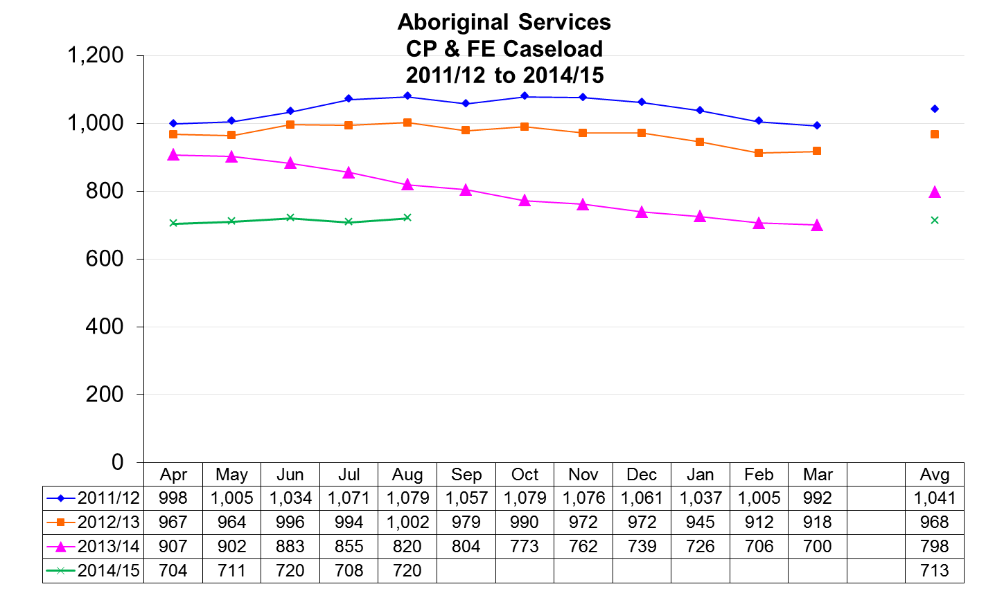

Slide 24
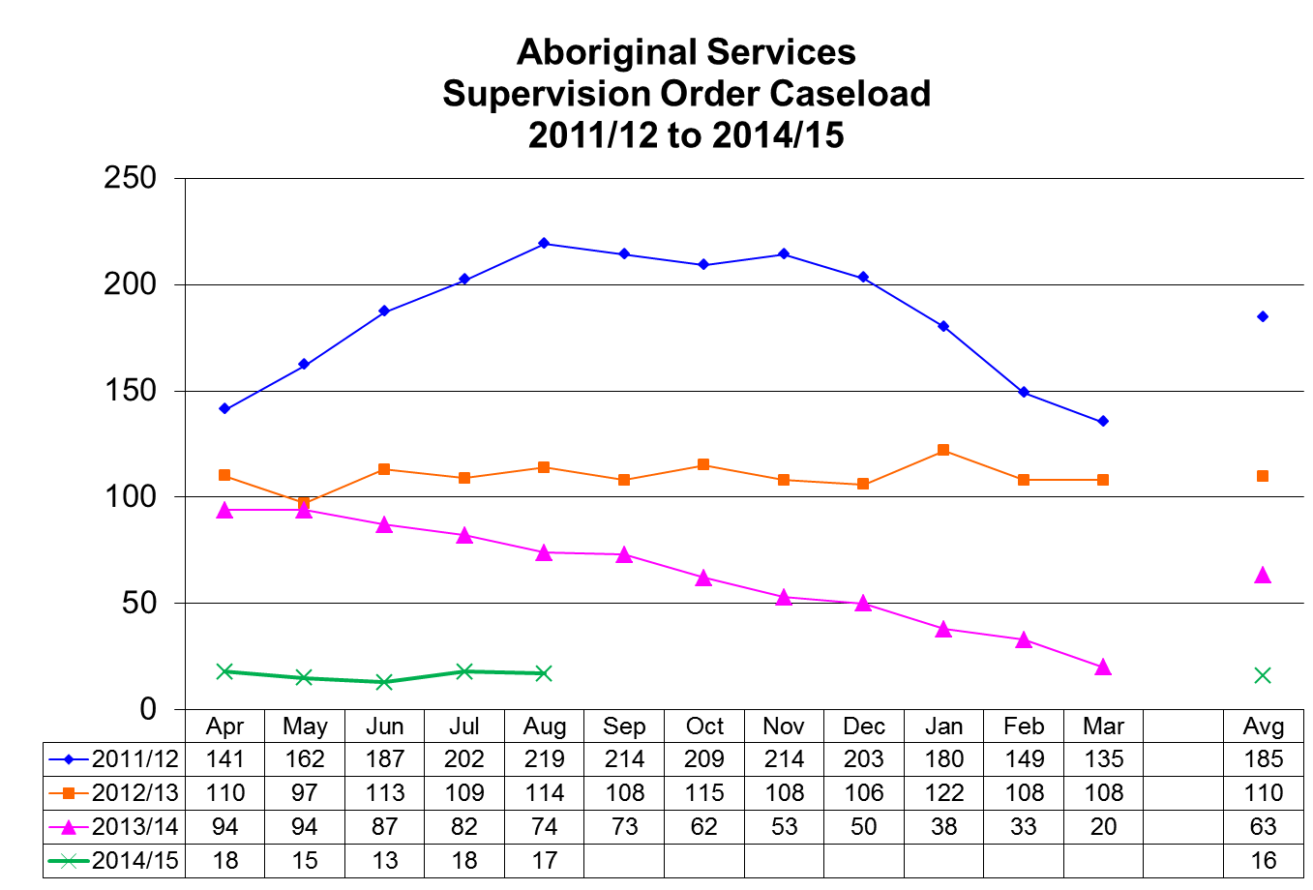

Slide 25
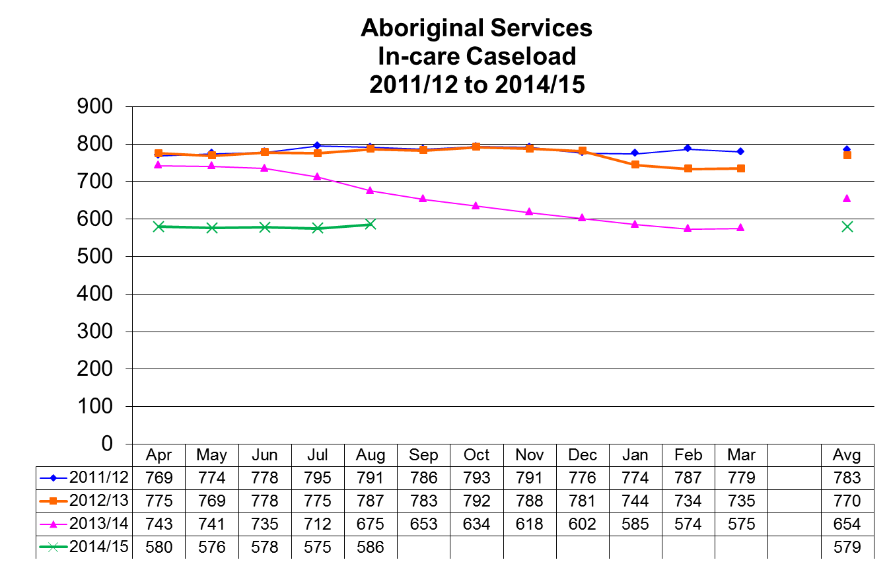

Slide 26
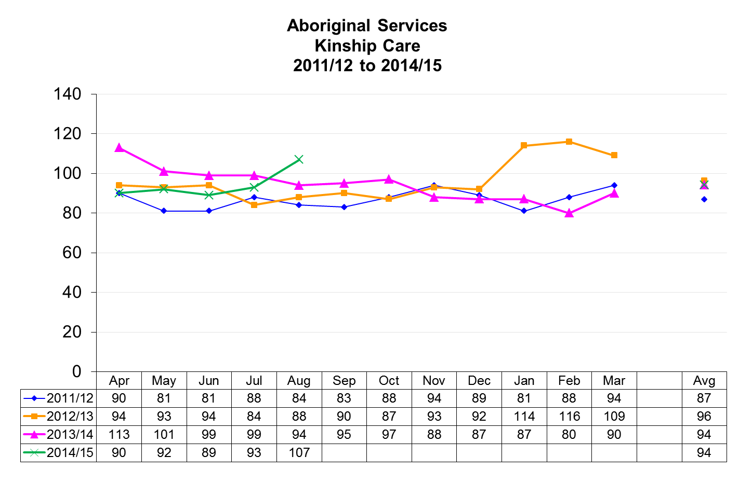

Slide 27
Questions?
HAVE A GREAT DAY!

