Slide 1
General Social Statistics Program
June 21, 2022

Slide 2
Presentation outline
Overview of General Social Statistics Program
Modernization initiatives
Canadians at Work and at Home
Families
Giving, Volunteering and Participating

Slide 3
Methodology
Target population
population aged 15 and older, living in the 10 provinces of Canada, and not residing in institutions
Victimization cycle also includes persons living in the territories
Sample size
Approximately 20,000-25,000 completed interviews, unless oversamples are purchased
Innovations
Electronic Questionnaires (EQ) used since 2013 for some cycles, for all cycles 2018 and onwards
On-going efforts to reduce response burden (e.g. record linkage)
GSS Modernization Program started in 2017

Slide 4
CONTENT THEMES & STAKEHOLDERS
TIME USE
(2015)
CANADIANS AT WORK AND AT HOME (2016)
FAMILIES
(2017)
CAREGIVING & CARE -RECEIVING (2018)
GIVING, VOLUNTEERING & PARTICIPATING (2018)
VICTIMIZATION
(2019)
SOCIAL IDENTITY
(2020-21)
24 hour diary
Main activity
Duration
Simultaneous activity
Location
Work activities
Unpaid services
Hired paid help
Transportation
Work-life balance
Well-being
Compensation and employment benefits
Work intensity, satisfaction and meaning
Intercultural workplace relations
Bullying and harassment in the workplace
Family time
Work-life balance
Sports/outdoor and cultural activities
Childhood/Parents
Home leaving
Marriages &common- law
Children
Fertility intentions
Parental leave
Organization and decision making within the household
Separation/Divorce
Well-being
Housing characteristics
Care receiving
Primary caregiver
Main health condition
Types of help, number of hours
Caregiving
Care receiver
Main health condition
Types of help, number of hours
Consequences of caregiving
Health and well-being
Volunteering—formal and informal
Organizations
Hours
Main activities
Reasons for not volunteering
Financial giving
Organizations
Amount
Reasons for giving/not giving
Other giving
Housing Characteristics, Neighbourhood & Trust
Crime Prevention, Risks and Perceptions
Criminal Victimization Screening
Abuse by Current /Previous Partner
Spousal/Ex-spousal Abuse Report
Crime Incidents
Other Types of Victimization
Social Networks
Civic Participation
Canadian History, Symbols, and Shared Values
Birthplace, Ethnic Origin, and Visible Minority Status (respondent, spouse and parents)
Pride, Sense of Belonging, Trust and Discrimination
Health and Well-being
Centre for Gender, Diversity and Inclusion Statistics
System of National Accounts
Economic Statistics Division
Women and Gender Equality Canada (WAGE)
Canadian Heritage
United Nations Statistics Division (UNSD)
Academics
Canadian Heritage
ESDC
Finance Canada
Sports Canada
Centre for Demography
Social Analysis and Modelling Division
Health Analysis Division
Vanier Institute for the Family
Women and Gender Equality
Department of Justice
ESDC
Academics
Vanier Institute of the Family
Women and Gender Equality
Public Health Agency
Health Canada
ESDC
CIHI
Non-profit orgs
International (ILO)
Academics
Imagine Canada
Volunteer Canada
Employment and Social Development Canada
Finance Canada
Canada Revenue Agency
Canadian Heritage
Health Canada
Non-profit institutions
Households Satellite Account (SNA)
Academics
CCJCSS (and their stakeholders such as POLIS)
Department of Justice
Public Safety
Crown-Indigenous Relations and Northern Affairs Canada
Indigenous Services Canada
Women and Gender Equality
FPTs
Academics
Canadian Heritage
IRCC
Public Safety Canada
Department of Justice
Health Canada
Public Health Agency of Canada
Indigenous and Northern Affairs Canada
ESDC
Community groups and organizations
Academics

Slide 5
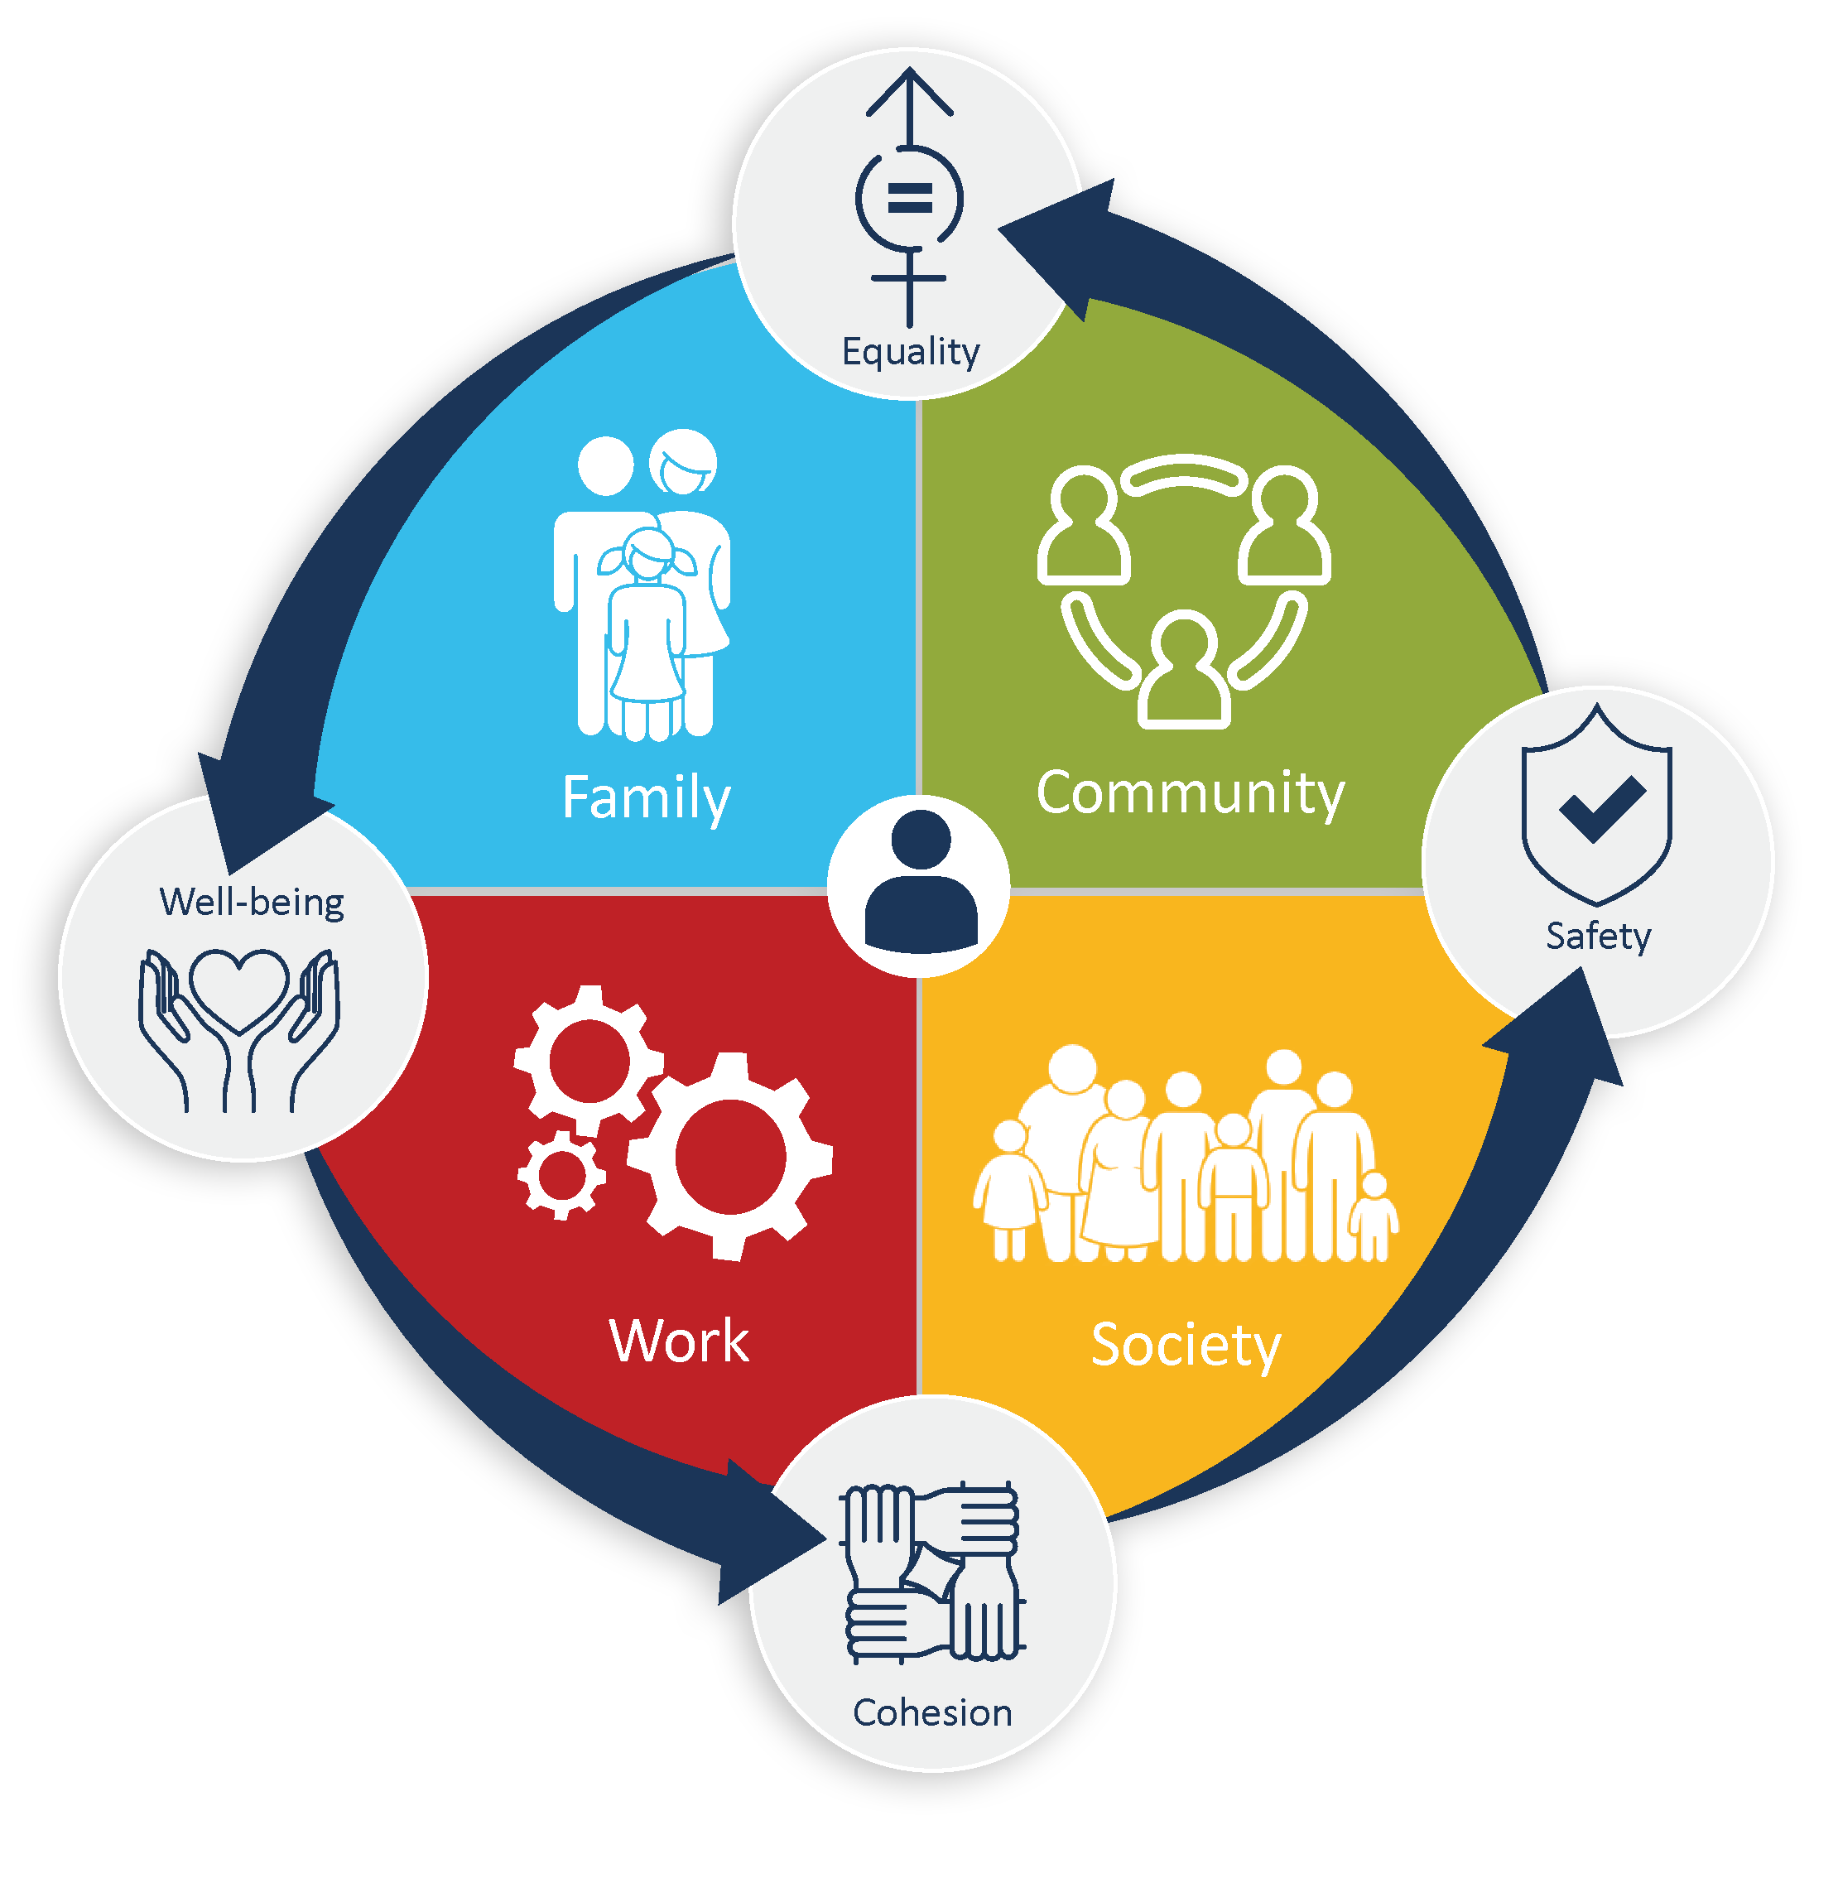
GENERAL SOCIAL STATISTICS PROGRAM
Providing information on specific social policy issues of current emerging interest and to understand changes in the living conditions and well-being of Canadians over time
Rich analytical files provided by in-depth surveys enable nuanced analyses that support “deep dives” into the social conditions of Canadians (for example, Time Use, Families, Victimization, etc.)
Use of administrative data, modelling, and modernized survey vehicles allows for data integration, improved timeliness, and reduced respondent burden
Greater ability to disaggregate estimates through enhanced sample power, beginning with Social Identity (2020), to better understand experiences of diverse groups of Canadians
Strong program governance and expanded engagement with partners and stakeholders through a re-established Social Conditions Advisory Committee and Steering Committee

Slide 6
Providing data to key indicator frameworks Social Inclusion, Quality of Life, Gender Result, Canadian Indicator
Should
Well-being
Good governance
Civic pride and belonging
Safety
Job quality
Subjective well being
Life satisfaction
Time Use
Voter participation
Political engagement
Trust in public and social institutions
Trust in government
Trust in justice system
Participation in community activities/artistic events/sports
Volunteering/charitable donations
Sense of belonging/pride
Social networks
Perceptions of diversity
Trust in others
Victimization
Discrimination
Hate crime
Cyber bullying
Perceptions of safety

Slide 7
Standard products
Articles and infographics
Data tables
Detailed microdata files in Research Data Centres and via RTRA
Public Use Microdata Files
Custom tables (cost-recovery)

Slide 8
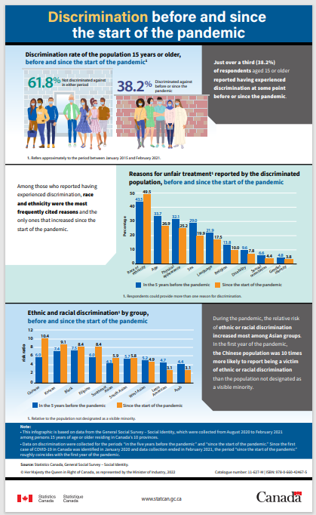
Recent analytical articles using GSS data
Family Matters: Parental leaves in Canada
A snapshot of pride in Canadian achievements among designated groups
Portrait of Canadian Society: Perceptions of life during the pandemic
Canadian Social Survey: COVID-19 and well-being
Contact with children after separation or divorce
Changes in fertility intentions in response to the COVID-19 pandemic
Discrimination before and since the start of the pandemic
Regional variations in multiple partner fertility in Canada (Canadian Studies in Population)
COVID-19 and Fertility in Canada: a Commentary (Canadian Studies in Population)

Slide 9
Modernization initiatives

Slide 10
Overview of Social Data Integration Platform (SDIP) Collection Tools
Crowdsource
Omnibus
Web Panel
DDAP Diverse Panel
Large call for volunteers (inference to population not possible)
5-10 minutes content
EQ questionnaire
Urgent need for timely data, difficult to reach populations
Quick to process
rEQ and iEQ follow-up
6 week collection
Sample size 20,000
20-25 minutes / 70 questions (including socio-demographics)
Can pool quarters for data disaggregation
Final file 6-8 weeks after collection
EQ only
1 week collection period
Smaller sample size (PCS off GSS SI around 8,000)
10 minutes / 15-20 questions
Standard demographics already collected
Final file 6-8 weeks after collection
EQ and iEQ follow-up
6-12 weeks of collection (depending on wave)
Sample 60,000-80,000
10 minutes / 20 questions
Oversample of population groups designated as visible minorities
Can use variables from the Census

Slide 11
Canadian Social Survey (Omnibus) – Waves 1-4 Timeline with Content Themes
Standard Demographic Content
Date of birth /age
Sex at birth / gender
Number of household members
Geographic region of residence
Place of birth (country)
Citizenship
Immigration status
Year of immigration / period of immigration
Indigenous identity
Long-term conditions / self-identified person with disability
Marital status
Sexual orientation
Highest certificate, diploma or degree completed
Main activity (working, going to school, retired, household work, caregiving, illness, vacation, volunteering, looking for paid work, other
Population group / visible minority group
Language
Conjugal Status
W1
W2
W3
W4
Apr 2021
Sept 24,
2021
Aug 2021
Nov 24, 2021
Oct 2021
Jan 2022
Oct 2021
Feb 21, 2022
May 17, 2022
Life Couse Analysis
Self-rated health
Self-rated mental health
Stress
Sense of belonging to local community
Life Satisfaction
Resilience
Behaviours related to COVID-19
Health behaviours
Experiences with COVID-19
COVID-19 Vaccination
QoL
Self-rated health and mental health
Life Satisfaction
Sense of meaning and purpose
Sense of belonging to local community
Someone to count on
Loneliness
Future Outlook
Ability to meet financial needs
Work-life balance
Satisfaction with division of chores in household
Perceived discrimination or unfair treatment
QoL
Self-rated health and mental health
Life Satisfaction
Sense of meaning and purpose
Sense of belonging to local community
Someone to count on
Loneliness
Future Outlook
Ability to meet financial needs
Work-life balance
Satisfaction with division of chores in household
Perceived discrimination or unfair treatment
QoL
Self-rated health and mental health
Life Satisfaction
Sense of meaning and purpose
Sense of belonging to local community
Someone to count on
Loneliness
Future Outlook
Ability to meet financial needs
Work-life balance
Satisfaction with division of chores in household
Perceived discrimination or unfair treatment
GSS
Couples living apart together
Changes to intimate couple relationships during the pandemic
Intentions to have children and changes due to the pandemic
GSS
Participation in outdoor/wilderness activities (series)
Participation in cultural activities (series)
Domain satisfaction (series)
Time use and perception of time (series)
Use of technology (series)
Tenure
GSS
Main activity and education of partner
Stress and sleep
Unpaid services
Hired paid help
Family time
Couples living apart together
Life changes since the beginning of the COVID-19 pandemic
Intentions to have children and changes due to the pandemic
COVID-19 Vaccination
GSS
Main activity and education of partner
Couples living apart together
Life changes since the beginning of the COVID-19 pandemic
Intentions to have children and changes due to the pandemic
Conditions for having children
Relationship disagreements
COVID-19 Vaccination

Slide 12
Canadian Social Survey (Omnibus) – Waves 5-8 Timeline with Content Themes
Standard Demographic Content
Date of birth /age
Sex at birth / gender
Number of household members
Geographic region of residence
Place of birth (country)
Citizenship
Immigration status
Year of immigration / period of immigration
Indigenous identity
Long-term conditions / self-identified person with disability
Marital status
Sexual orientation
Highest certificate, diploma or degree completed
Main activity (working, going to school, retired, household work, caregiving, illness, vacation, volunteering, looking for paid work, other
Population group / visible minority group
Language
Conjugal Status
W5
W6
W7
W8
Apr 2022
Aug 2022
July 2022
November 2022
October 2022
February 2023
January 2023
May 2023
QoL
Self-rated health and mental health
Life Satisfaction
Sense of meaning and purpose
Sense of belonging to local community
Someone to count on
Loneliness
Future Outlook
Ability to meet financial needs
Work-life balance
Satisfaction with division of chores in household
Perceived discrimination or unfair treatment
QoL
Life Satisfaction
Sense of meaning and purpose
Sense of belonging to local community
Someone to count on
Loneliness
Future Outlook
Ability to meet financial needs
Work-life balance
Satisfaction with time use
Satisfaction with local environments
Emergency preparedness
Perceived discrimination or unfair treatment
QoL
Satisfaction with work life balance
General health
Life Satisfaction
Meaning and purpose
View of the future
Loneliness
Sense of belonging to local community
Someone to count on
Satisfaction with time use
Satisfaction with local environments
Financial well-being
Emergency preparedness
TBD
TBD
GSS
Reason for choosing place of residence
Ethnic and cultural origins of ancestors
Importance of ethnic or cultural origins
Shared values
Sense of belonging
Trust in people
Trust in different groups of people
Trust in neighbourhood people
Confidence in institutions
GSS
Self-rated health and mental health
Caregiving and care work for people aged 15 years or older
Caregiving and care work for people under the age of 15 years old
Impacts of unpaid and paid care work
CSDII
Trust in people
Trust in different groups of people
Confidence in institutions
Rising prices
Life opportunities
Dwelling
Discrimination or unfair treatment in Canada
Total household income
Total personal income
DEM
Language
CCES
Education
DEM
Language
…..
DEM
Language

Slide 13
SDIP- Status of Current Projects
Omnibus
Wave 1: Canadian Social Survey – COVID-19 and Well-being- Released Sept 24 2021
“Changes in fertility intentions in response to the COVID-19 pandemic”- Released December 1, 2021
Wave 2: Canadian Social Survey – Well-being, Activities and Perception of Time- Released Nov 24 2021
Wave 3: Canadian Social Survey – Well-being, Unpaid Work and Family- Released Feb 21 2022
Wave 4: Canadian Social Survey – Well-being and Family Relationships- Released May 17 2022
Wave 5: Canadian Social Survey – Well-being, Shared Values and Trust- Collection started April 22 2022
Wave 6: Canadian Social Survey – Well-being and Caregiving - Collection starts July 15 2022
Northern Omnibus- Collection Oct/Nov 2022
Web Panel
Wave 1: Portrait of Canadian Society – Perceptions of Life During the Pandemic- Released Sept 24 2021
Wave 2: Portrait of Canadian Society – Experiences During the Pandemic- Released Sept 27 2021
Wave 3: Portrait of Canadian Society – Social Impacts of Inflation- Collection April 19, Release June 14 2022
Survey Series on People and their Communities Wave 1- Collection Nov 2022 TBD

Slide 14
DDAP Diverse Panel (Survey Series on People and their Communities) Proposed design and content
Objectives
Comparisons between visible minority groups and also with non-visible minority population
Descriptive statistics of visible minority groups, focusing on intersectionality
Domains of interest
Visible Minority groups (seven most populous groups)
Gender
Immigration - recent immigrants and established immigrants
Education
Age group
Geography
Proposed content (1st panel)
Participation in groups
Trust and belonging
Confidence in institutions

Slide 15
Canadians at Work and at Home

Slide 16
Canadians at work and at home
Objectives
To identify lifestyle behaviours in Canada that impact health and well-being
To provide data on the social aspects of work life and the relationship between work and home life
To identify new trends and issues in Canadian society
Target population and sample size:
Those aged 15 and over living in the 10 provinces
Field sample approximately 40,000
Collection mode:
EQ and CATI
Collection dates:
August to December 2016
Some content is being collected on the Canadian Social Survey

Slide 17
Canadians at work and at home survey content
Life at work
Work ethic, workload and work distribution
Job satisfaction and meaning
Skills, training and job security
Compensation and benefits
Workplace social relations
Life at home
Outdoor activities
Sports participation
Cultural participation
Use of technology
Eating habits and nutrition

Slide 18
Canadians at work and at home survey content
Work-life balance
Satisfaction with quantity and quality of time spent together
Division of chores within household
Balancing work-home responsibilities
Health, well-being and resilience
Self-rated health
Satisfaction with various aspects of life
Subjective well-being
Stress management
Life opportunities
Life aspiration and outlook
Resilience
Disability screening questions

Slide 19
Family Survey

Slide 20
Why a family survey?
To better understand how demographic changes have affected the composition of households and families, and the number and types of transitions experienced by families.
The Families cycle is special because it collects not only cross-sectional indicators, but rather a series of questions on the timing of life-course events that allow for reconstructing the entire family life-course of individuals, which is difficult to obtain from administrative data.
To date there have been 6 Family cycles
1990 (cycle 5)
1995 (cycle 10)
2001 (cycle 15)
2006 (cycle 20)
2011 (cycle 25)
2017 (cycle 31)

Slide 21
Survey methodology (2017)
Conducted by computer assisted telephone interviewing (CATI)
Average interview length 45 to 60 minutes
Data were collected over 10 months
Population aged 15 and over living in private households in the 10 provinces
Final sample of 20,602 respondents
Response rate 52.4%

Slide 22
Collecting information on the family life-course
The survey collects biographical information on the family life course of Canadians. Events and when these were experienced are collected in order to measure the diversity of family situations and the plurality of family paths
The family survey interviews an individual about their parents, their family life course, and other events and characteristics.
It cannot derive the number of children, unions or families in Canada.

Slide 23
Key survey content
Parents’ history (childhood, characteristics of parents)
Leaving the household
Union trajectories (union formation, break-ups)
Fertility history (birth, adopted and stepchildren)
Fertility intentions
Other characteristics (of the respondent and current spouse/partner)

Slide 24
2024 Family Survey: Timelines
Consultations
March-April 2022
Questionnaire
content
April-June 2022
Qualitative testing
Summer 2022
Application development
Summer 2022-Summer 2023
Collection
Early 2024

Slide 25
Informing policy and research
Informing policy-making:
Childcare use and planning
Assessing impacts of past policies on family behavior (i.e. impact of universal childcare on fertility)
Assessing specific needs of complex families
Gender wage gap & conjugal trajectories
Informing research:
Family complexity (stepfamilies, multiple partner fertility)
Trends in transition to adulthood, such as social polarization in timing of life-course transitions
Childbearing within common-law unions and within marriage
Family complexity & financial outcomes
Work-family balance
Gender division of household tasks & fertility intentions
Impacts of family policy on childbearing
Microsimulation of population fertility by education, immigration status, conjugal status

Slide 26
Publications
The Daily — Contact with children after divorce or separation
Family Matters: Parental leaves in Canada
Family Matters: Family ties: How often do adult children see their parents?
Family Matters: Splitting household tasks: Who does what?
Family Matters: Being separated or divorced and aged 55 or older
Family Matters: New relationships after separation or divorce
Family Matters: Being married or common-law in Canada
Family matters: Being separated or divorced in Canada
Family Matters: Long-lasting relationships
Family Matters: Who lives alone?
Family Matters: Couples who live apart
Family Matters: Under the same roof, living with my parents!
Family Matters: Grandparents in Canada

Slide 27
Giving, Volunteering and Participating Survey (GVP)

Slide 28
Context
At Statistics Canada data collection on Giving and Volunteering began in 1997.
Last data collection took place between September 4 and December 28, 2018.
The target population included all persons 15 years of age and older living in the ten provinces (excluding full-time residents of institutions).
The target sample size (i.e., the number of respondents excluding ‘rejected’ respondents) for the 2018 GSS GVP was 20,000, while the actual number of respondents (again excluding ‘rejected’ respondents) was 16,149.
The 2018 GVP offered an Internet option to survey respondents for the first time to reduce the demands on time. It is, therefore, not appropriate to compare results from this cycle with that of previous cycles.
These data are pre-COVID-19, but provide important baseline information.
In 2023, Statistics Canada will be collecting data on this for the eighth time.

Slide 29
Major stakeholders and partners
Government:
Canadian Heritage
Health Canada
Canada Revenue Agency
Employment and Social Development Canada
Department of Finance Canada
Non-government:

Slide 30
New information
NEW!
The 2018 Giving, Volunteering and Participating survey was the first to report on:
The distinction between hours of informal and formal volunteering.
Informal volunteering distinguished by direct help and community improvement; that is helping people directly and involvement to improve the community, on one’s own, and through activities not on behalf of a group or an organization.
The question on mandatory volunteering in the context of formal volunteering was extended to all volunteer hours. In 2013, the question on mandatory hours was only asked of organizations where the respondent volunteered the most hours; in 2018, it was asked in reference to all volunteer hours.
Number of volunteering hours supported by employers.
International definition of volunteering, which excludes activities that are mandatory/required or supported by an employer and direct help given to relatives living outside the household.

Slide 31
GVP inputs and dependencies
GVP generates four main indicators, namely the participation rates for volunteering and donations as well as the respective amounts of time and money. As such, this data is of great benefit to users, but one of GVP's unique strengths is the ability to associate this information with different non-profit industry sectors.
Since the 2018 survey, GVP allows a measure of volunteering in accordance with the 19th International Conference of Labour Statisticians (ICLS).
GVP survey data are provided to the Non-profit Institutions Serving Households (NPISH) sector account which offers several benefits to researchers, economists, policy makers and national accountants. An understanding of the economic contribution of NPISH to the production of goods and services in Canada points to the importance of NPISH within the Canadian economy.
The usefulness of GSS GVP data is not limited to government programs and policies alone. This survey also serves as a reference for program and service decisions by organizations with a range of charitable and community-based missions in the volunteer and giving sector. As such, data requests and tables are ordered annually from Statistics Canada by these charitable and non-profit organizations.

Slide 32
Core Content
Volunteering
Formal - Unpaid activity on behalf of a group or organization
Informal - Unpaid activity not on behalf of a group or organization
Helping others directly
Improving community directly
Giving
Financial giving
Other giving
donations of clothes, household items and food to charities; includes donations of money directly to people
Other characteristics: Youth experiences, Education, Labour market activities, Employer support, Country of birth and citizenship, Aboriginal group, Health and subjective well-being, Length of time respondent has lived in city or local community, Religion, Language, Disability screening questions, Veteran

Slide 33
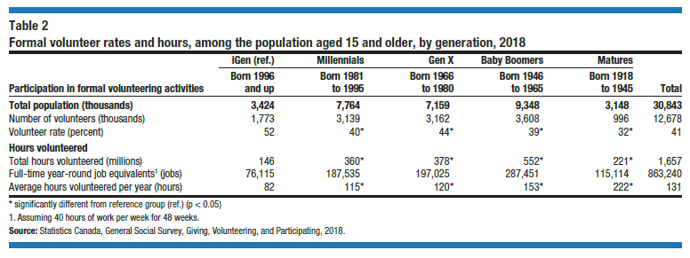
Formal Volunteering
12.7 million Canadians engaged in formal volunteering.
41% of Canadians dedicated 1.6 billion hours.
Formal volunteering decreased with age although hours volunteered were highest among the oldest generations.
The older generations were more likely to be top volunteers.
Mandatory unpaid work, expressed as a percentage of total formal volunteer hours, was highest among iGens, but still made up a fairly small portion of the total formal hours contributed by iGens (10E%).
Activities conducted without pay on behalf of a group or organization, at least once in the 12 months preceding the survey

Slide 34
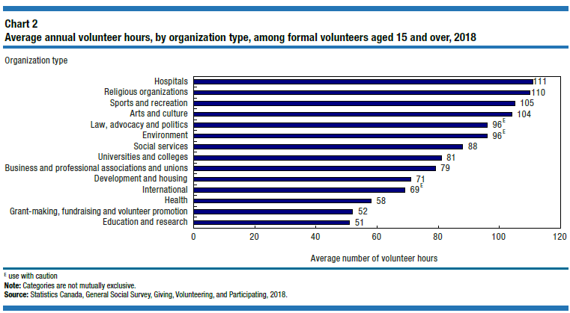
Formal Volunteering: Organization types
The average number of volunteer hours were highest among hospitals (111 hours), religious organizations (110 hours), sports and recreation (105 hours), and arts and culture (104 hours).
Formal volunteers gave about half as many hours to the four sectors receiving the fewest number of volunteer hours: education and research (51 hours); grant-making, fundraising and volunteer promotion (52 hours); and health-related services, such as crisis intervention services, outpatient clinics, and rehabilitation services (58 hours).

Slide 35
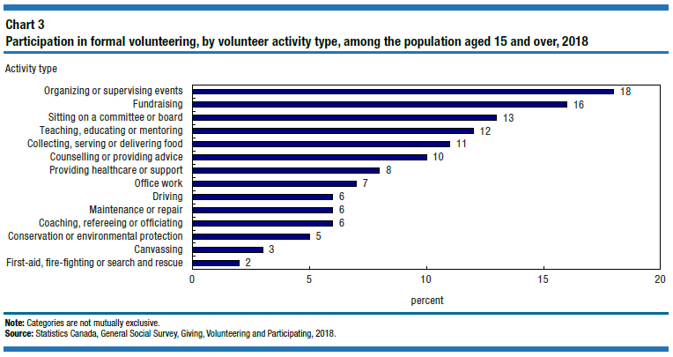
Formal volunteering: Activity types
Organizing or supervising events were the most commonly reported formal volunteer activity
iGens were more likely to participate in this activity type as well as teaching, educating or mentoring
Baby Boomers were more likely to sit in a committee or board as well as to provide driving services.

Slide 36
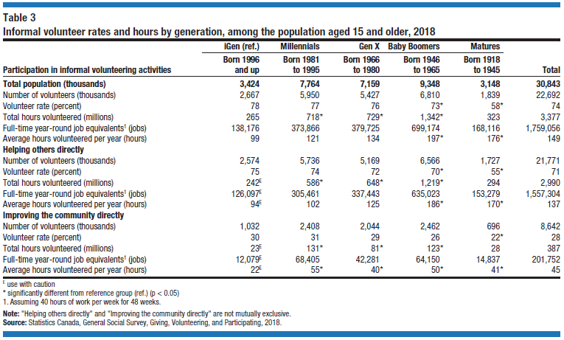
Informal volunteering
Activities conducted without pay not on behalf of a group or organization, at least once in the 12 months preceding the survey
23 million Canadians engaged in informal volunteering.
74% of Canadians dedicated 3.4 billion hours.
Few generational differences although iGen had a higher informal volunteer rate than Baby Boomers and Matures.
The older generations dedicated more hours to informal volunteer work.
62% of all hours given to help others directly went to tasks for relatives outside the household.

Slide 37
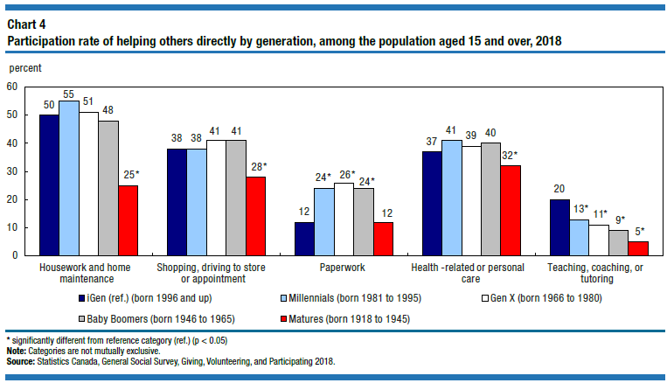
Informal volunteering: Helping others directly
iGen was more likely to help others by teaching, coaching or tutoring.
Matures were less likely than other generations to help others directly with almost all tasks, such as housework, health‑related or personal care, shopping, and teaching/coaching.
Older generations gave the most hours of support, on average, to health‑related or personal care activities.
Matures dedicated the most average hours to teaching, coaching or tutoring at 74E hours, nearly four times higher than the average annual hours reported by iGens (20E hours).

Slide 38
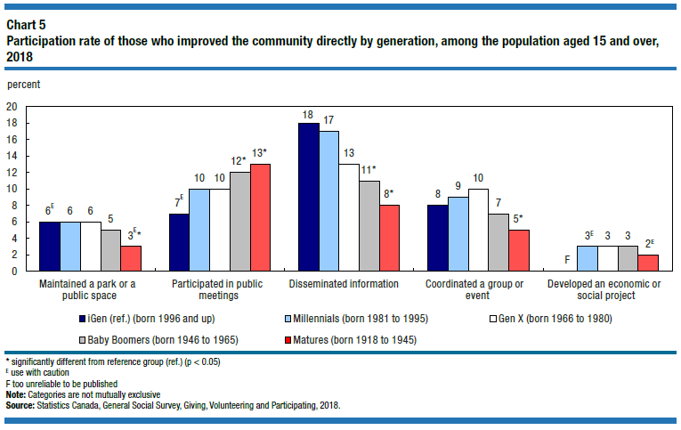
Informal volunteering: Improving community directly
The youngest generation was more likely to disseminate information than Baby Boomers and Matures.
The older generation was more likely to participate in public meetings in which there was discussion of community affairs.
Matures were less likely to maintain a park or public space or coordinate a group or event.
There were no differences in hours contribute across generations.

Slide 39
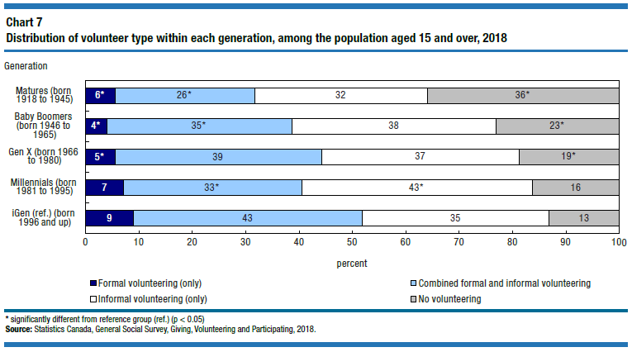
Total participation across volunteer types
Canadians can participate in a variety of volunteering types – be it exclusively formal volunteering or informal volunteering, or blend of both.
For the first time, the GVP 2018 is able to classify volunteers into these mutually exclusive categories.
The overall volunteering rate was 79% (24 million Canadians).
The majority of Canadians volunteered informally exclusively (38%), followed by combined formal and informal (35%) and 6% of Canadians participated in formal volunteering exclusively.
Overall volunteering tends to decrease from younger to older generations.

Slide 40
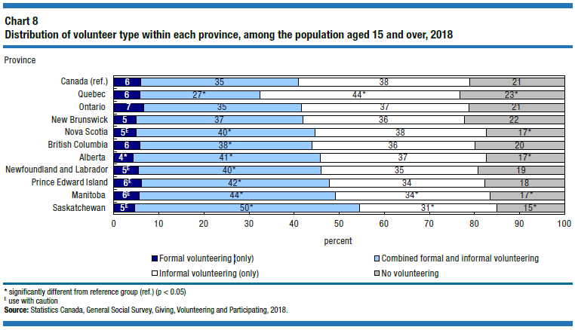
Volunteer types across Canada
The participation rate in formal volunteer activities was highest in Saskatchewan (55%) and lowest in Quebec (33%).
Saskatchewan also had and higher rates of informal volunteering compared to Quebec (81% vs 71%).
Quebec had the highest rate of informal volunteering exclusively (44%).
Provinces like Quebec have similar rates of overall volunteering when examining volunteering participation across volunteer types.

Slide 41
Timeline next GVP survey
Consultations: June to August 2022
Content development: August to October 2022
Qualitative tests: TBD
Development of the application: fall 2022 to summer 2023
Collection: September 2023

Slide 42
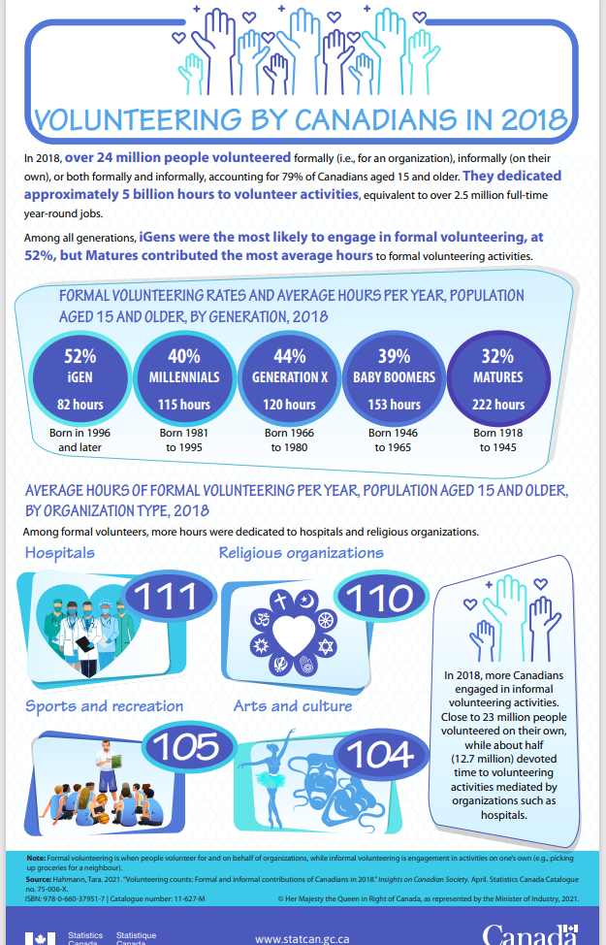
Releases
Insights on Canadian Society
Volunteering counts: Formal and informal contributions of Canadians in 2018
https://www150.statcan.gc.ca/n1/pub/75-006-x/2021001/article/00002-eng.htm
https://www150.statcan.gc.ca/n1/pub/11-627-m/11-627-m2021035-eng.htm
Volunteering in Canada: Challenges and opportunities during the COVID-19 pandemic
https://www150.statcan.gc.ca/n1/pub/45-28-0001/2020001/article/00037-eng.htm
CODR tables
Donor rate and average annual donations, by ...
https://www150.statcan.gc.ca/t1/tbl1/en/tv.action?pid=4510003201
Volunteer rate and average annual volunteer hours, by definition of volunteering and ...
https://www150.statcan.gc.ca/t1/tbl1/en/tv.action?pid=4510004001

Slide 43
Thank you! / Merci !
Questions?

